Slide 1
EECS 490 – Lecture 25 Parallel Computing

Slide 2
Announcements
Project 5 due Tue 12/12 at 8pm
Final survey due Thu 12/14 at 8pm
Office hours in discussion this week, in the discussion rooms
No lecture on Tue 12/12
Office hours instead, in 2632 BBB

Slide 3
Final Exam
Thursday, 12/21 10:30am-12:30pm
DOW 1010 for uniqnames that start with a-i
DOW 1017 for uniqnames that start with j-z
Comprehensive, with emphasis on Lectures 13-25 (Operational Semantics through Parallel Computing)
Covers all material in notes except:
§6.3.5 (Nested Iteration)
§7.2 (Asynchronous Tasks)

Slide 4
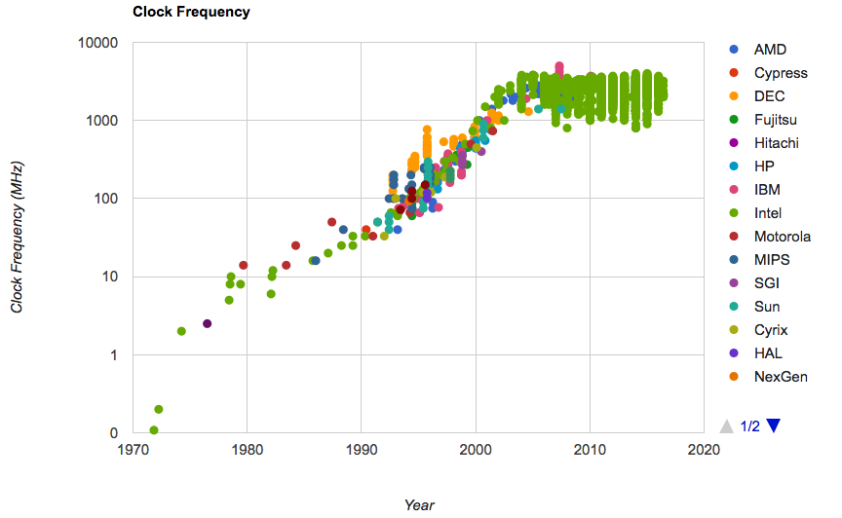

CPU Performance
Performance of individual CPU cores has largely stagnated in recent years

Slide 5
Parallelism
Applications must be parallelized in order run faster
Waiting for a faster CPU core is no longer an option
Parallelism is easy in functional programming:
When a program contains only pure functions, call expressions can be evaluated in any order, lazily, and in parallel
Referential transparency: a call expression can be replaced by its value (or vice versa) without changing the program
We will look at MapReduce, a framework for such computations
But not all problems can be solved efficiently using functional programming, so we will also look at strategies for parallelism with mutable shared state

Slide 6
MapReduce Evaluation Model
Map phase: Apply a mapper function to inputs, emitting a set of intermediate key-value pairs
The mapper takes an iterator over inputs, such as text lines
The mapper yields zero or more key-value pairs per input
Reduce phase: For each intermediate key, apply a reducer function to accumulate all values associated with that key
The reducer takes an iterator over key-value pairs
All pairs with a given key are consecutive
The reducer yields 0 or more values, each associated with that intermediate key
EECS 490
map
a: 0, e: 2, i: 0, o: 0, u: 0
group
a: 0, a: 3, a: 3
reduce
a: 6
e: 2, e: 0, e: 1
reduce
e: 3
is a class about
map
a: 3, e: 0, i: 1, o: 1, u: 1
i: 0, i: 1, i: 1
reduce
i: 2
programming languages
map
a: 3, e: 1, i: 1, o: 1, u: 1
o: 0, o: 1, o: 1
reduce
o: 2
u: 0, u: 1, u: 1
reduce
u: 2

Slide 7
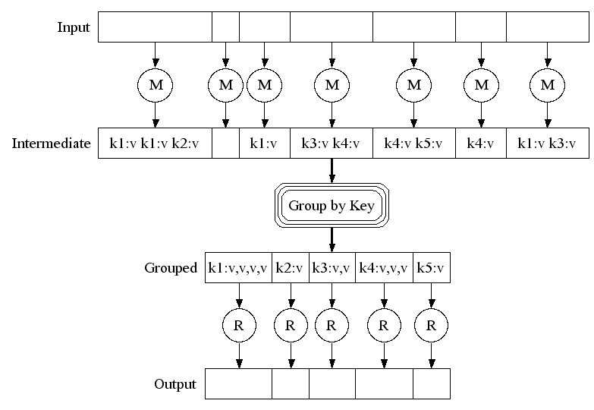
MapReduce Execution Model

Slide 8
Parallel Computation Patterns
Not all problems can be solved efficiently using functional programming
The Berkeley View project has identified 13 common computational patterns in engineering and science:
MapReduce is only one of these patterns
The rest require shared mutable state
Dense Linear Algebra
Sparse Linear Algebra
Spectral Methods
N-Body Methods
Structured Grids
Unstructured Grids
MapReduce
Combinational Logic
Graph Traversal
Dynamic Programming
Backtrack and Branch-and-Bound
Graphical Models
Finite State Machines

Slide 9
Parallelism in Python
Python provides two mechanisms for parallelism
Threads execute in the same interpreter, sharing all data
However, the CPython interpreter executes only one thread at a time, switching between them rapidly at (mostly) arbitrary points
Operations external to the interpreter, such as file and network I/O, may execute concurrently
Processes execute in separate interpreters, generally not sharing data
Shared state can be communicated explicitly between processes
Since processes run in separate interpreters, they can be executed in parallel as the underlying hardware and software allow
The concepts of threads and processes exist in other systems as well

Slide 10
Threads in Python
The threading module contains classes that enable threads to be created and synchronized from threading import Thread, current_thread def thread_hello(): other = Thread(target=thread_say_hello, args=()) other.start() thread_say_hello() def thread_say_hello(): print('hello from', current_thread().name)
Start the other thread
Function that new thread should run
Function arguments
>>> thread_hello()
hello from Thread-1
hello from MainThread
Print output unordered

Slide 11
Processes in Python
The multiprocessing module contains classes that enable processes to be created and synchronized from multiprocessing import Process, current_process def process_hello(): other = Process(target=process_say_hello, args=()) other.start() process_say_hello() def process_say_hello(): print('hello from', current_process().name)
Start the other process
Function that new process should run
Function arguments
>>> process_hello()
hello from Process-1
hello from MainProcess
Print output unordered

Slide 12
The Problem with Shared State
Shared state that is mutated and accessed concurrently by multiple threads can cause subtle bugs from threading import Thread counter = [0] def increment(): counter[0] = counter[0] + 1 other = Thread(target=increment, args=()) other.start() increment() other.join() print('count is now', counter[0])
What is the value of counter[0] at the end?
Wait until the other thread completes

Slide 13
Atomic Operations
Only the most basic operations are atomic, taking effect instantaneously, in CPython or any other system
Even in a mostly sequential system like CPython, a non-atomic operation can be interrupted by another thread
The increment is actually several atomic operations Thread 0 Thread 1 read counter[0]: 0 read counter[0]: 0 calculate 0 + 1: 1 write 1 -> counter[0] calculate 0 + 1: 1 write 1 -> counter[0]
The counter can end up with a value of 1, even though it was incremented twice!

Slide 14
Race Conditions
A situation where multiple threads concurrently access the same data, and at least one thread mutates it, is called a race condition
Race conditions are difficult to debug, since they may only occur very rarely
Access to shared data in the presence of mutation must be synchronized in order to prevent access by other threads while a thread is mutating the data
Managing shared state is a key challenge in parallel computing
Under-synchronization doesn’t protect against race conditions and other parallel bugs
Over-synchronization prevents non-conflicting accesses from occurring in parallel, reducing a program’s efficiency
Incorrect synchronization may result in deadlock, where different threads indefinitely wait for each other in a circular dependency
We will see some basic tools for managing shared state

Slide 15
Synchronized Data Structures
Some data structures guarantee synchronization, so that their operations are atomic from queue import Queue queue = Queue() def increment(): count = queue.get() queue.put(count + 1) other = Thread(target=increment, args=()) other.start() queue.put(0) increment() other.join() print('count is now', queue.get())
Synchronized FIFO queue
Wait until an item is available
Add initial value of 0

Slide 16
Synchronization with a Lock
A lock ensures that only one thread at a time can hold it
Once it is acquired, no other threads may acquire it until it is released from threading import Thread, Lock counter = [0] counter_lock = Lock() def increment(): counter_lock.acquire() count = counter[0] counter[0] = count + 1 counter_lock.release() other = Thread(target=increment, args=()) other.start() increment() other.join() print('count is now', counter[0])
A lock is a context manager
with counter_lock:
count = counter[0]
counter[0] = count + 1

Slide 17
Break Time!
We’ll start again in five minutes.

Slide 18
Example: Web Crawler
A web crawler is a program that systematically browses the Internet
For example, we might write a web crawler that validates links on a website, recursively checking all links hosted by the same site
A parallel crawler may use the following data structures:
A queue of URLs that need processing
A set of URLs that have already been seen, to avoid repeating work and getting stuck in a circular sequence of links
The synchronized Queue class can be used for the URL queue
There is no synchronized set in the Python library, so we must provide our own synchronization using a lock

Slide 19
Web Crawler Synchronization
URL coordination code: def put_url(url): """Queue the given URL.""" queue.put(url) def get_url(): """Retrieve a URL.""" return queue.get() def already_seen(url): """Check if a URL has already been seen.""" with seen_lock: if url in seen: return True seen.add(url) return False

Slide 20
Example: Particle Simulation
A set of particles all interact with each other (e.g. short range repulsive force)
The set of particles is divided among all threads or processes
Forces are computed from particles’ positions
Their positions constitute shared data
The simulation is discretized into timesteps

Slide 21
Example: Particle Simulation
In each timestep, each thread or process must:
Read the positions of every particle (read shared data)
Update acceleration of its own particles (access non-shared data)
Update velocities of its own particles (access non-shared data)
Update positions of its own particles (write shared data)
Steps 1 and 4 conflict with each other
Concurrent reads are OK
Writes are to different locations

Slide 22
Solution 1: Barriers
In each timestep, each thread or process must:
Read the positions of every particle (read shared data)
Update acceleration of its own particles (access non-shared data)
Update velocities of its own particles (access non-shared data)
Update positions of its own particles (write shared data)
Steps 1 and 4 conflict with each other
We can solve the conflict by dividing the program into phases, ensuring that the phases do not overlap
A barrier is a synchronization mechanism that enables this from threading import Barrier barrier = Barrier(num_threads) barrier.wait()
Waits until num_threads threads reach it

Slide 23
Solution 2: Message Passing
Alternatively, we can explicitly pass state from the thread/process that owns it to those that need to use it
In each timestep, every process makes a copy of its own particles
Then, they do the following num_processes-1 times:
Interact with the copy that is present
Send the copy to the left, receive from the right
Thus, reads are on copies, so they don’t conflict with writes

Slide 24
Summary
Parallelism is necessary for performance, due to hardware trends
But parallelism is hard in the presence of mutable shared state
Access to shared data must be synchronized in the presence of mutation
Making parallel programming easier is one of the central challenges that Computer Science faces today

Slide 25
Where to Go from Here
Related classes
EECS 483 and 583: Compilers
EECS 590: Advanced Programming Languages
Read language specifications
Python's is very accessible
cppreference.com for C++
Practice using the programming paradigms we've learned
Use the right tool for the job
Keep up with new language features
C++17: structured bindings, template argument deduction on constructors, parallel STL algorithms, constexpr if, etc.

Slide 26
Good Luck on the Project and Exam!

